Slide 1

Vue.js
Paris - 2021
Animated by : Mohammed BAHRI
(Developer & Web Trainer)

Slide 2
VUE.JS
Learn Vue.js
PROGRAM
Introduction
The essentials of view.js
Advanced aspects
More: Exploiting an API (REST)
Conclusion

Slide 3

WELCOME : Roundtable
Who are you, your job?
What are your professional goals?
What are your knowledge on the subject?

Slide 4
INTRODUCTION

Slide 5
Vue.js : Introduction
Vue.js (also called simply View), is an open-source JavaScript framework used to build user interfaces.
The library is used by Adobe, Alibaba and Gitlab.
Vue was created by Evan You after working for Google using AngularJS in several projects.

Slide 6

Vue.js : Introduction
Creator : Evan You (尤 雨 溪)
First version : February 11, 2014
Latest Version : 2.6.10 (March 20, 2019)
Deposit : https://github.com/vuejs/view
Written in Javascript
Type : JavaScript Framework
License : MIT License
Website : https://vuejs.org

Slide 7
Vue.js : Installation
<!DOCTYPE html>
<html>
<meta charset="utf-8"/>
<script src="https://unpkg.com/vue@next"></script>
<body>
</body>
</html>​

Slide 8
Vue.js : Instance
<!DOCTYPE html>
<html>
<meta charset="utf-8"/>
<script src="https://unpkg.com/vue@next"></script>
<body>
<div id="app">
{{ message }}
</div>
<script>
const app = Vue.createApp({
data() {
return {
message: 'Hello World!'
}
}
}).mount('#app')
</script>
</body>
</html>​

Slide 9
Vue.js : Data (attribute) : Array
<!DOCTYPE html>
<html>
<meta charset="utf-8"/>
<script src="https://unpkg.com/vue@next"></script>
<body>
<div id="app">
{{ cars[0] }}
{{ cars[1] }}
{{ cars[2] }}
</div>
<script>
const app = Vue.createApp({
data() {
return {
cars : ['BMW','RENAULT','PEUGEOT']
}
}
}).mount('#app')
</script>
</body>
</html>​

Slide 10
Vue.js : Data (attribute) : Object
<!DOCTYPE html>
<html>
<meta charset="utf-8"/>
<script src="https://unpkg.com/vue@next"></script>
<body>
<div id="app">
{{ cars.v1 }}
{{ cars.v2 }}
{{ cars.v3 }}
</div>
<script>
const app = Vue.createApp({
data() {
return {
cars: { v1:'BMW', v2: 'RENAULT', v3: 'PEUGEOT'}
}
}
}).mount('#app')
</script>
</body>
</html>

Slide 11

Vue.js : Exercise 1
Create an instance containing the name, age and occupation of a person.
Display information using expressions ({{ }}).
Example:

Slide 12
Vue.js : Corrected 1
<!DOCTYPE html>
<html>
<meta charset="utf-8"/>
<script src="https://unpkg.com/vue@next"></script>
<body>
<div id="app">
<p>Hello {{ name }}, you are {{ age }} years old and you are {{ profession }}.</p>
</div>
<script>
const app = Vue.createApp({
data() {
return {
name: 'Bahri',
age: 32,
profession: 'web trainer'
}
}
}).mount('#app')
</script>
</body>
</html>

Slide 13
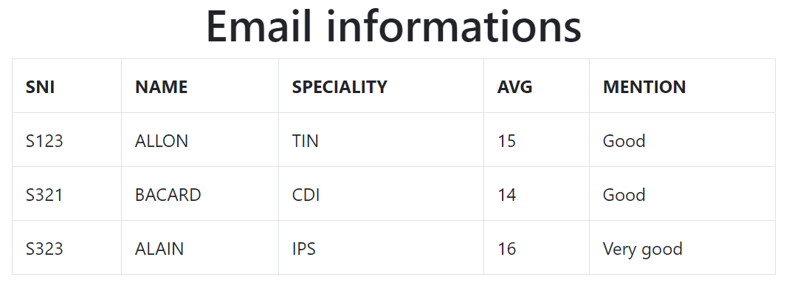
Vue.js : Exercise 2
Transform the table below into Vuejs data and then display it using bootsrap4.
Notes:
<!DOCTYPE html>
<html>
<meta charset="utf-8"/>
<link rel="stylesheet" href="https://stackpath.bootstrapcdn.com/bootstrap/4.3.1/css/bootstrap.min.css">
<script src="vue.js"></script>
<body>
<div id="app" class="container" align=center>
<h1>{{ parentMessage }}</h1>
<table class="table table-bordered">
<tr>
<th>SNI</th>
<th>NAME</th>
<th>SPECIALITY</th>
<th>AVG</th>
<th>MENTION</th>
</tr>
<tr>
<td> {{ items[0].nsi }} </td>
<td> {{ items[0].name }} </td>
<td> {{ items[0].speciality }} </td>
<td> {{ items[0].avg }} </td>
<td> {{ items[0].mention }} </td>
</tr>
</table>
<script>
var app = new Vue({
el: '#app',
data: {
parentMessage: 'Email informations',
items: [
{ nsi : 'S123',
name : "ALLON",
speciality : "TIN",
avg : 15,
mention : "Good"
}
]
}
})
</script>
</body>
</html>​

Slide 14
Vue.js : Corrected 2 (1)
<!DOCTYPE html>
<html>
<meta charset="utf-8"/>
<link rel="stylesheet" href="https://maxcdn.bootstrapcdn.com/bootstrap/4.0.0/css/bootstrap.min.css">
<script src="https://unpkg.com/vue@next"></script>
<body>
<div id="app" class="container">
<h1>{{ parentMessage }}</h1>
<table class="table table-bordered text-center">
<tr>
<th>SNI</th>
<th>NAME</th>
<th>SPECIALITY</th>
<th>AVG</th>
<th>MENTION</th>
</tr>
<tr>
<td> {{ items[0].nsi }} </td>
<td> {{ items[0].name }} </td>
<td> {{ items[0].speciality }} </td>
<td> {{ items[0].avg }} </td>
<td> {{ items[0].mention }} </td>
</tr>
</table>

Slide 15
Vue.js : Corrected 2 (2)
<script>
const app = Vue.createApp({
data(){
return{
parentMessage: 'Email informations',
items: [
{ nsi : 'S123', name : 'ALLON', speciality : 'TIN', avg : 15, mention : 'Good'},
{ nsi : 'S321', name : 'DAVID', speciality : 'IPS', avg : 16, mention : 'Good'},
// …
]
}
}
}).mount('#app')
</script>
</div>
</body>
</html>

Slide 16
Vue.js : Function (Method)
<!DOCTYPE html>
<html>
<meta charset="utf-8"/>
<script src="https://unpkg.com/vue@next"></script>
<body>
<div id="app">
<p>{{ message }}</p>
<button v-on:click="reverseMessage">Reverse Message</button>
</div>
<script>
const app = Vue.createApp({
data() {
return {
message: 'Hello World!'
}
},
methods: {
reverseMessage: function () {
this.message = this.message.split('').reverse().join('')
}
}
}).mount('#app')
</script>
</body>
</html>​

Slide 17
Vue.js : Function (Method) with {{ … }}
<!DOCTYPE html>
<html>
<meta charset="utf-8"/>
<script src="https://unpkg.com/vue@next"></script>
<body>
<div id="app">
<p>{{ hello('Daniel') }}</p>
</div>
<script>
const app = Vue.createApp({
methods: {
hello: function (name) {
return 'Hello ' + name
}
}
}).mount('#app')
</script>
</body>
</html>​

Slide 18
Vue.js : Exercise 3
Create a method taking the name, age and occupation of a person as parameter and then returns them.
Call the method using expressions ({{ }}).
Example:

Slide 19
Vue.js : Corrected 3
<!DOCTYPE html>
<html>
<meta charset="utf-8"/>
<script src="https://unpkg.com/vue@next"></script>
<body>
<div id="app">
<p>{{ getMessage('Bahri', 32, 'web trainer') }}</p>
</div>
<script>
const app = Vue.createApp({
methods: {
getMessage: function (name, age, profession) {
return 'Hello ' + name + ', you are ' + age + ' years old and you are ' + profession
}
}
}).mount('#app')
</script>
</body>
</html>​

Slide 20
Vue.js : Exercise 4
Create an instance containing the name, age and occupation of a person.
Create a method (named constructor ()) to initialize the attributes of the instance.
Create a method (named display ()) to display the instance data.
Test the methods using expressions ({{ }}).
Example:

Slide 21
Vue.js : Corrected 4
<!DOCTYPE html>
<html>
<meta charset="utf-8"/>
<script src="https://unpkg.com/vue@next"></script>
<body>
<div id="app">
{{ constructor('Bahri',32,'web trainer') }}
<p>{{ show() }}</p>
</div>
<script>
const app = Vue.createApp({
methods: {
constructor: function(name, age, profession) {
this.name = name;
this.age = age;
this.profession = profession;
},
show: function() {
return 'Hello ' + this.name + ', you are ' + this.age + ' years old.'
}
}
}).mount('#app')
</script>
</body>
</html>​

Slide 22
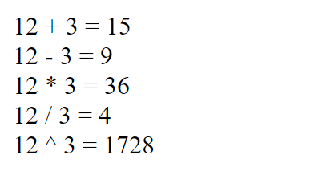
Vue.js : Exercise 5
Create an instance containing methods to do:
The addition, subtraction, multiplication and division of two parameters.
Test the methods using expressions ({{ }}).
Example:

Slide 23
Vue.js : Corrected 5
<!DOCTYPE html>
<html>
<meta charset="utf-8"/>
<script src="https://unpkg.com/vue@next"></script>
<body>
<div id="app">
<p>{{ addition(12,3) }}</p>
</div>
<script>
const app = Vue.createApp({
methods: {
addition: function(x,y){ return x + ' + ' + y + ' = ' + (x + y); },
subtraction: function(x,y){ return x + ' - ' + y + ' = ' + (x - y); },
multiplication: function(x,y){ return x + ' * ' + y + ' = ' + (x * y); },
division: function(x,y){ return x + ' / ' + y + ' = ' + (x / y); },
exponentiation: function(x,y){ return x + ' ^ ' + y + ' = ' + Math.pow(x,y); }
}
}).mount('#app')
</script>
</body>
</html>​

Slide 24
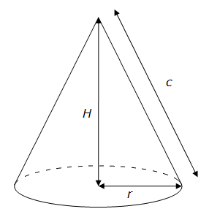
Vue.js : Exercise 6
Write a parameterized function that calculates the volume of a cone.
Rule: Volume = (Radius² * Height * Π) / 3

Slide 25
Vue.js : Corrected 6
<!DOCTYPE html>
<html>
<meta charset="utf-8"/>
<script src="https://unpkg.com/vue@next"></script>
<body>
<div id="app">
{{ volumeConeCalculate(12,3) }}
<p>{{ vc }}</p>
</div>
<script>
const app = Vue.createApp({
data(){
return {
vc:0,
}
},
methods: {
volumeConeCalculate: function(radius, height){
this.vc = (height * Math.pow(radius,2) * Math.PI) / 3;
}
}
}).mount('#app')
</script>
</body>
</html>​

Slide 26
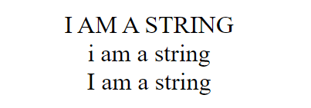
Vue.js : Exercise 7
Create an instance containing methods for formatting a string in :
Upper, Lower and capitalize case.
Test the methods using expressions ({{ }}).
Example:

Slide 27
Vue.js : Corrected 7
<!DOCTYPE html>
<html>
<meta charset="utf-8"/>
<script src="https://unpkg.com/vue@next"></script>
<body>
<div id="app">
<p>{{ toUpper('i am a string') }}</p>
<p>{{ toLower('I am a STRING') }}</p>
<p>{{ toCapitalize('i AM a string') }}</p>
</div>
<script>
const app = Vue.createApp({
methods: {
toUpper: function (str) { return str.toUpperCase() },
toLower: function (str) { return str.toLowerCase() },
toCapitalize: function (str) { return str.charAt(0).toUpperCase() + str.slice(1).toLowerCase() }
}
}).mount('#app')
</script>
</body>
</html>​

Slide 28
Vue.js : V-Bind
<!DOCTYPE html>
<html>
<meta charset="utf-8"/>
<script src="https://unpkg.com/vue@next"></script>
<body>
<div id="app">
<p v-bind:title="message">
Hover your mouse over me for a few seconds to see my dynamically bound title!
</p>
</div>
<script>
const app = Vue.createApp({
data(){
return {
message: 'You loaded this page on ' + new Date().toLocaleString()
}
}
}).mount('#app')
</script>
</body>
</html>​

Slide 29
Vue.js : Bind (Shortcuts)
<!DOCTYPE html>
<html>
<meta charset="utf-8"/>
<script src="https://unpkg.com/vue@next"></script>
<body>
<div id="app">
<p :title="message">
Hover your mouse over me for a few seconds to see my dynamically bound title!
</p>
</div>
<script>
const app = Vue.createApp({
data(){
return {
message: 'You loaded this page on ' + new Date().toLocaleString()
}
}
}).mount('#app')
</script>
</body>
</html>​

Slide 30
Vue.js : Loop
<!DOCTYPE html>
<html>
<meta charset="utf-8"/>
<script src="https://unpkg.com/vue@next"></script>
<body>
<div id="app">
<span v-for="n in 10"> {{ n }} </span>
</div>
<script>
const app = Vue.createApp({
}).mount('#app')
</script>
</body>
</html>​

Slide 31
Vue.js : Loop
<!DOCTYPE html>
<html>
<meta charset="utf-8"/>
<script src="https://unpkg.com/vue@next"></script>
<body>
<ul id="app">
<li v-for="item in items">
{{ item }}
</li>
</ul>
<script>
const app = Vue.createApp({
data(){
return {
items: ['BMW', 'Renault']
}
}
}).mount('#app')
</script>
</body>
</html>​

Slide 32
Vue.js : Loop
<!DOCTYPE html>
<html>
<meta charset="utf-8"/>
<script src="https://unpkg.com/vue@next"></script>
<body>
<ul id="app">
<li v-for="(item, index) in items">
{{ index }} - {{ item }}
</li>
</ul>
<script>
const app = Vue.createApp({
data(){
return {
items: ['BMW', 'Renault']
}
}
}).mount('#app')
</script>
</body>
</html>​

Slide 33
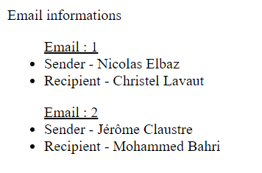
Vue.js : Exercise 8
items:
[
{ Sender:'Nicolas Elbaz', Recipient:'Christel Lavaut' },
{ Sender: 'Jérôme Claustre', Recipient: 'Mohammed Bahri' }
]

Slide 34
Vue.js : Corrected 8
<!DOCTYPE html>
<html>
<meta charset="utf-8"/>
<script src="https://unpkg.com/vue@next"></script>
<body>
<div id="app">
<span>{{ parentMessage }}</span>
<ul v-for="(item, index) in items">
<u> Email : {{ index + 1 }} </u>
<li v-for="(it, ix) in item">
{{ ix }} - {{ it }}
</li>
</ul>
</div>
<script>
const app = Vue.createApp({
data(){
return {
parentMessage: 'Email informations',
items: [{ Sender: 'Nicolas Elbaz', Recipient: 'Christel Lavaut' },
{ Sender: 'Jérôme Claustre', Recipient: 'Mohammed Bahri' }]
}
}
}).mount('#app')
</script>
</body>
</html>​

Slide 35

Vue.js : Exercise 9
Create a loop producing a horizontal line of 10 hearts.
Example:

Slide 36
Vue.js : Corrected 9
<!DOCTYPE html>
<html>
<meta charset="utf-8"/>
<script src="https://unpkg.com/vue@next"></script>
<body>
<div id="app">
<span v-for="n in 10">&spades;</span>
</div>
<script>
const app = Vue.createApp({
}).mount('#app')
</script>
</body>
</html>​

Slide 37

Vue.js : Exercise 10
Use the loops to produce the rendering below :

Slide 38
Vue.js : Corrected 10
<!DOCTYPE html>
<html>
<meta charset="utf-8"/>
<script src="https://unpkg.com/vue@next"></script>
<body>
<div id="app">
<ol type="a">
<span v-for="n in 5">
<li>
<span v-for="n in 10">
<img src="v.png" width="20px">
</span>
</li>
</span>
</ol>
</div>
<script>
const app = Vue.createApp({
}).mount('#app')
</script>
</body>
</html>​

Slide 39
Vue.js : Condition
<!DOCTYPE html>
<html>
<meta charset="utf-8"/>
<script src="https://unpkg.com/vue@next"></script>
<body>
<div id="app">
<span v-if="seen">Now you see me</span>
</div>
<script>
const app = Vue.createApp({
data(){
return {
seen: true
}
}
}).mount('#app')
</script>
</body>
</html>​

Slide 40
Vue.js : Condition
<!DOCTYPE html>
<html>
<meta charset="utf-8"/>
<script src="https://unpkg.com/vue@next"></script>
<body>
<div id="app">
<div v-if="type == 'A'">
Yes
</div>
<div v-else-if="type == 'B'">
No
</div>
<div v-else>
I don’t know!
</div>
</div>
<script>
const app = Vue.createApp({
data(){
return {
type: 'A'
}
}
}).mount('#app')
</script>
</body>
</html>​

Slide 41
Vue.js : Using ternary
<!DOCTYPE html>
<html>
<meta charset="utf-8"/>
<script src="https://unpkg.com/vue@next"></script>
<body>
<div id="app">
<p>{{ (age >= 18) ? 'YES' : 'NO' }}</p>
</div>
<script>
const app = Vue.createApp({
data(){
return {
age: 17
}
}
}).mount('#app')
</script>
</body>
</html>​

Slide 42
Vue.js : Exercise 11
Write a conditional expression to display a message if a person is both a major and a developer.
Example : "Hello Sarah! You are welcome!".
If not, the expression displays "Sorry! You are not authorized".

Slide 43
Vue.js : Corrected 11
<!DOCTYPE html>
<html>
<meta charset="utf-8"/>
<script src="https://unpkg.com/vue@next"></script>
<body>
<div id="app">
<div v-if="age >= 18 && profession == 'dev'">
Hello {{ name }}! You are welcome!
</div>
<div v-else>
Sorry you are not allowed!
</div>
</div>
<script>
const app = Vue.createApp({
data(){
return {
age:17,
profession:'dev',
name:'Sarah'
}
}
}).mount('#app')
</script>
</body>
</html>​

Slide 44
Vue.js : v-if vs v-show
<!DOCTYPE html>
<html>
<meta charset="utf-8"/>
<script src="https://unpkg.com/vue@next"></script>
<body>
<div id="app">
<div v-if="access">Hello! You are welcome!</div>
<!-- -->
<div v-show="access">Hello! You are welcome! </div>
<!-- div style="display: none;">Hello! You are welcome! </div -->
</div>
<script>
const app = Vue.createApp({
data(){
return {
access:false
}
}
}).mount('#app')
</script>
</body>
</html>​

Slide 45
Vue.js : Events
<!DOCTYPE html>
<html>
<meta charset="utf-8"/>
<script src="https://unpkg.com/vue@next"></script>
<body>
<div id="app">
<button v-on:click="counter += 1">Add 1</button>
<!-- button @click="counter += 1">Add 1</button -->
<p>Le bouton ci-dessus a été cliqué {{ counter }} fois.</p>
</div>
<script>
const app = Vue.createApp({
data(){
return {
counter: 0
}
}
}).mount('#app')
</script>
</body>
</html>​

Slide 46
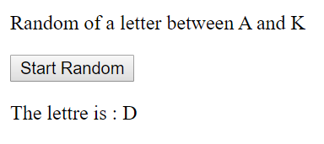
Vue.js : Exercise 12

Slide 47
Vue.js : Corrected 12
<!DOCTYPE html>
<html>
<meta charset="utf-8"/>
<script src="https://unpkg.com/vue@next"></script>
<body>
<div id="app">
<p>Random of a letter between A and K</p>
<button v-on:click="random">Start Random</button>
<p>The lettre is : {{ lettre }} </p>
</div>
<script>
const app = Vue.createApp({
data(){
return {
lettres: ['A','B','C','D','E','F','J','H','I','G','K'],
lettre: ''
}
},
methods:{
random: function(){
var x = Math.floor(Math.random() * 11);
this.lettre = this.lettres[x];
}
}
}).mount('#app')
</script>
</body>
</html>​

Slide 48


Vue.js : Exercise 13
mouseover
mouseout

Slide 49
Vue.js : Corrected 13
<!DOCTYPE html>
<html>
<meta charset="utf-8"/>
<script src="https://unpkg.com/vue@next"></script>
<body>
<div id="app">
<div v-bind:style="styleobj" v-on:mouseover="changebgcolor" v-on:mouseout="originalcolor"></div>
</div>
<script>
const app = Vue.createApp({
data(){
return {
styleobj : {
width:"100px",
height:"100px",
backgroundColor:"red"
}
}
},
methods : {
changebgcolor : function() { this.styleobj.backgroundColor = "green"; },
originalcolor : function() { this.styleobj.backgroundColor = "red"; }
}
}).mount('#app')
</script>
</body>
</html>​

Slide 50
Vue.js : HTML
<!DOCTYPE html>
<html>
<meta charset="utf-8"/>
<script src="https://unpkg.com/vue@next"></script>
<body>
<div id="app">
<span v-html="msg"></span>
<span>{{ msg }}</span>
</div>
<script>
const app = Vue.createApp({
data(){
return {
msg: '<p><strong>Hello</strong></p>'
}
}
}).mount('#app')
</script>
</body>
</html>​

Slide 51
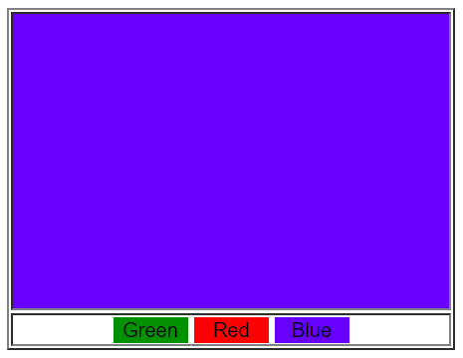
Vue.js : Exercise 14

Slide 52
Vue.js : Corrected 14 (1)
<!DOCTYPE html>
<html>
<meta charset="utf-8"/>
<style>
button{ border:none; width:50px; }
.green { background-color: green; }
.red { background-color: red; }
.blue { background-color: blue; }
</style>
<script src="https://unpkg.com/vue@next"></script>
<body>
<div id="app">
<table width="300px" border=1>
<tr v-html="color" height='200px'></tr>
<tr>
<td align="center">
<button v-on:click="getGreen" class="green">Green</button>
<button v-on:click="getRed" class="red">Red</button>
<button v-on:click="getBlue" class="blue">Blue</button>
</td>
</tr>
</table>
</div>

Slide 53
Vue.js : Corrected 14 (2)
<script>
const app = Vue.createApp({
data() {
return {
color: '<td></td>'
}
},
methods: {
getGreen: function () { this.color = '<td class=\'green\'></td>' },
getRed: function () { this.color = '<td class=\'red\'></td>' },
getBlue: function () { this.color = '<td class=\'blue\'></td>' }
}
}).mount('#app')
</script>
</body>
</html>​

Slide 54
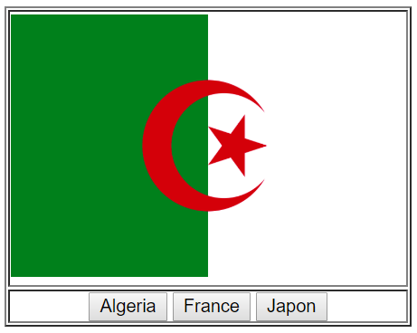
Vue.js : Exercise 15

Slide 55
Vue.js : Corrected 15 (1)
<!DOCTYPE html>
<html>
<meta charset="utf-8"/>
<script src="https://unpkg.com/vue@next"></script>
<body>
<div id="app">
<table width="300px" border=1 >
<tr>
<td v-html="img" height='200px'></td>
</tr>
<tr>
<td align="center">
<button v-on:click="getAlgeria">Algeria</button>
<button v-on:click="getFrance">France</button>
<button v-on:click="getJapon">Japon</button>
</td>
</tr>
</table>
</div>

Slide 56
Vue.js : Corrected 15 (2)
<script>
const app = Vue.createApp({
data() {
return {
img: ''
}
},
methods: {
getAlgeria: function () { this.img = '<img src=\'algeria.png\' width=\'100%\'>' },
getFrance: function () { this.img = '<img src=\'france.png\' width=\'100%\'>' },
getJapon: function () { this.img = '<img src=\'japon.png\' width=\'100%\'>' }
}
}).mount('#app')
</script>
</body>
</html>​

Slide 57
Vue.js : CSS
<!DOCTYPE html>
<html>
<meta charset="utf-8"/>
<style>
.active { color:green }
</style>
<script src="https://unpkg.com/vue@next"></script>
<body>
<div id="app">
<div v-bind:class="{ active: isActive }">Some text...</div>
</div>
<script>
const app = Vue.createApp({
data() {
return {
isActive: true,
}
}
}).mount('#app')
</script>
</body>
</html>​

Slide 58
Vue.js : CSS
<!DOCTYPE html>
<html>
<meta charset="utf-8"/>
<style>
.active { color:green }
</style>
<script src="https://unpkg.com/vue@next"></script>
<body>
<div id="app">
<div v-bind:style="{ color: activeColor, fontSize: fontSize + 'px' }">
Some text...
</div>
</div>
<script>
const app = Vue.createApp({
data() {
return {
activeColor: 'red',
fontSize: 30
}
}
}).mount('#app')
</script>
</body>
</html>​

Slide 59
Vue.js : CSS
<!DOCTYPE html>
<html>
<meta charset="utf-8"/>
<style>
.active { color: green }
</style>
<script src="https://unpkg.com/vue@next"></script>
<body>
<div id="app">
<div v-bind:style="styleObject">Some text...</div>
</div>
<script>
const app = Vue.createApp({
data() {
return {
styleObject: {
color: 'red',
fontSize: '13px'
}
}
}
}).mount('#app')
</script>
</body>
</html>​

Slide 60
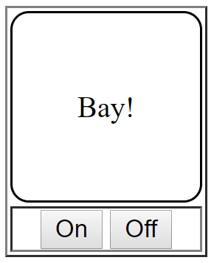
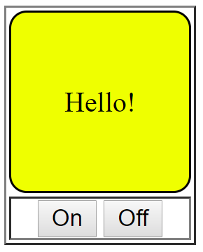
Vue.js : Exercise 16 CSS

Slide 61
Vue.js : Corrected 16 (1)
<!DOCTYPE html>
<html>
<meta charset="utf-8"/>
<style>
.active {
background-color: yellow;
}
.screen{
height:100px; width:100px;
border-radius: 10px; border: 1px solid black;
text-align: center
}
</style>
<script src="https://unpkg.com/vue@next"></script>
<body>
<div id="app">
<table border=1>
<tr>
<td class="screen" v-bind:class="{ active: isActive }">{{ message }}</td>
</tr>
<tr>
<td align="center">
<button v-on:click="on">On</button>
<button v-on:click="off">Off</button>
</td>
</tr>
</table>
</div>

Slide 62
Vue.js : Corrected 16 (2)
<script>
const app = Vue.createApp({
data() {
return {
isActive: false,
message: ''
}
},
methods: {
on: function () {
this.isActive = true;
this.message = 'Hello!';
},
off: function () {
this.isActive = false;
this.message = 'Bay!';
},
}
}).mount('#app')
</script>
</body>
</html>​

Slide 63
Vue.js : V-Model
<!DOCTYPE html>
<html>
<meta charset="utf-8"/>
<script src="https://unpkg.com/vue@next"></script>
<body>
<div id="app">
<input v-model="message">
<p>{{ message }}</p>
</div>
<script>
const app = Vue.createApp({
data() {
return {
message: 'Hello Vue!'
}
}
}).mount('#app')
</script>
</body>
</html>​

Slide 64
Vue.js : Input validation
<!DOCTYPE html>
<html>
<meta charset="utf-8"/>
<script src="https://unpkg.com/vue@next"></script>
<body>
<div id="app">
<label>Enter a name </label>
<input type="text" v-model="name" name="name">
<input type="submit" value="Submit" v-on:click="checkForm">
<p> {{ message }} </p>
</div>
<script>
const app = Vue.createApp({
data() {
return {
name: null, message: null
}
},
methods: {
checkForm: function () {
if (this.name) { this.message = 'Hello ' + this.name; }
else { this.message = 'Required field!'; }
}
}
}).mount('#app')
</script>
</body>
</html>​
Notes:
<!DOCTYPE html>
<html>
<meta charset="utf-8"/>
<script src="vue.js"></script>
<body>
<div id="app">
<label>Enter a name </label>
<input type="text" v-model="name" name="name">
<input type="submit" value="Submit" v-on:click="checkForm">
<p> {{ message }} </p>
</div>
<script>
var app = new Vue({
el: '#app',
data: {
name: null,
message:null
},
methods:{
checkForm: function () {
if (this.name) {
this.message = 'Hello ' + this.name;
} else {
this.message = 'Please complete all fields!';
}
}
}
})
</script>
</body>
</html>

Slide 65
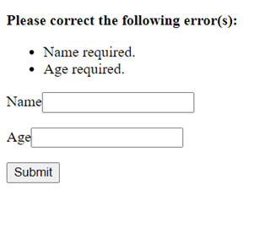
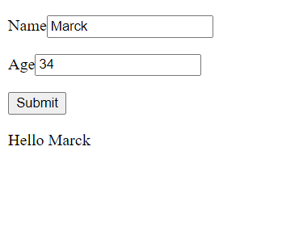
Vue.js : Exercise 17
Notes:
<!DOCTYPE html>
<html>
<meta charset="utf-8"/>
<script src="vue.js"></script>
<body>
<div id="app">
<p v-if="errors.length">
<b>Please correct the following error(s):</b>
<ul>
<li v-for="error in errors">{{ error }}</li>
</ul>
</p>
<p>
<label for="name">Name</label>
<input id="name" v-model="name" type="text" name="name">
</p>
<p>
<label for="age">Age</label>
<input id="age" v-model="age" type="number" name="age" min="0">
</p>
<p>
<label for="movie">Favorite Movie</label>
<select id="movie" v-model="movie" name="movie">
<option>Star Wars</option>
<option>Vanilla Sky</option>
<option>Atomic Blonde</option>
</select>
</p>
<p>
<input type="submit" value="Submit" v-on:click="checkForm">
</p>
<p> {{ message }} </p>
</div>
<script>
var app = new Vue({
el: '#app',
data: {
errors: [],
name: null,
age: null,
movie: null,
message:null
},
methods:{
checkForm: function () {
if (this.name && this.age) {
this.errors = [];
this.message = 'Hello ' + this.name;
}
if (!this.name) {
this.errors.push('Name required.');
}
if (!this.age) {
this.errors.push('Age required.');
}
}
}
})
</script>
</body>
</html>

Slide 66
Vue.js : Corrected 17
<!DOCTYPE html>
<html>
<meta charset="utf-8" />
<script src="https://unpkg.com/vue@next"></script>
<body>
<div id="app">
<p v-if="errors.length">
<b>Please correct the following error(s):</b>
<ul>
<li v-for="error in errors">{{ error }}</li>
</ul>
</p>
<p>
<label for="name">Name</label>
<input id="name" v-model="name" type="text" name="name">
</p>
<p>
<label for="age">Age</label>
<input id="age" v-model="age" type="number" name="age" min="0">
</p>
<p>
<input type="submit" value="Submit" v-on:click="checkForm">
</p>
<p>{{ message }}</p>
</div>

Slide 67
Vue.js : Corrected 17
<script>
const app = Vue.createApp({
data() {
return {
errors: [],
name: null,
age: null,
movie: null,
message: null
}
},
methods: {
checkForm: function () {
if (this.name && this.age) {
this.message = 'Hello ' + this.name
}
this.errors = [];
if (!this.name) { this.errors.push('Name required.'); }
if (!this.age) { this.errors.push('Age required.'); }
}
}
}).mount('#app')
</script>
</body>
</html>​

Slide 68
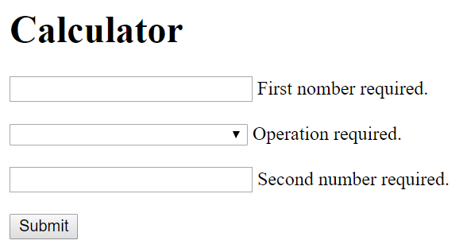
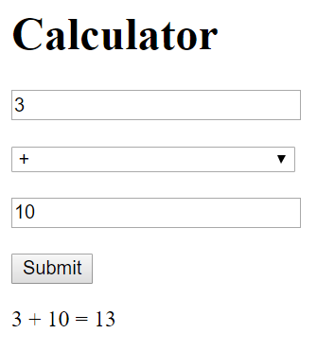
Vue.js : Exercise 18
Notes:
<!DOCTYPE html>
<html>
<meta charset="utf-8"/>
<script src="vue.js"></script>
<body>
<div id="app">
<h1>Calculator</h1>
<input id="nb1" v-model="nb1" type="number" name="nb1" min="0" class="input_width"> {{ nb1_error }}<br><br>
<select id="op" v-model="op" name="op" class="input_width">
<option value="+">+</option>
<option value="-">-</option>
<option value="/">/</option>
<option value="*">*</option>
</select>
{{ op_error }}<br><br>
<input id="nb2" v-model="nb2" type="number" name="nb2" min="0" class="input_width"> {{ nb2_error }}<br><br>
<input type="submit" value="Submit" v-on:click="checkForm">
<p> {{ message }} </p>
</div>
<script>
var app = new Vue({
el: '#app',
data: {
nb1: null,
nb2: null,
op: null,
nb1_error:null,
nb2_error:null,
op_error:null,
message:null
},
methods:{
checkForm: function () {
if (this.nb1 && this.nb2 && this.op) {
this.nb1_error = this.nb2_error = this.op_error = '';
if(this.op == '+'){
this.message = this.nb1 + " + " + this.nb2 + " = " + (parseFloat(this.nb1) + parseFloat(this.nb2));
} else if(this.op == '-'){
this.message = this.nb1 + " - " + this.nb2 + " = " + (parseFloat(this.nb1) - parseFloat(this.nb2));
} else if(this.op == '/'){
this.message = this.nb1 + " / " + this.nb2 + " = " + (parseFloat(this.nb1) / parseFloat(this.nb2));
} else if(this.op == '*'){
this.message = this.nb1 + " * " + this.nb2 + " = " + (parseFloat(this.nb1) * parseFloat(this.nb2));
}
}
this.nb1_error = (!this.nb1) ? 'First nomber required.' : '';
this.nb2_error = (!this.nb2) ? 'Second nomber required.' : '';
this.op_error = (!this.op) ? 'Operation required.' : '';
}
}
})
</script>
</body>
</html>

Slide 69
Vue.js : Corrected 18 (1)
<!DOCTYPE html>
<html>
<meta charset="utf-8" />
<script src="https://unpkg.com/vue@next"></script>
<body>
<div id="app">
<h1>Calculator</h1>
<input id="nb1" v-model="nb1" type="number" name="nb1" min="0" class="input_width">
{{ nb1_error }}<br><br>
<select id="op" v-model="op" name="op" class="input_width">
<option value="+">+</option>
<option value="-">-</option>
<option value="/">/</option>
<option value="*">*</option>
</select>
{{ op_error }}<br><br>
<input id="nb2" v-model="nb2" type="number" name="nb2" min="0" class="input_width">
{{ nb2_error }}<br><br>
<input type="submit" value="Submit" v-on:click="checkForm">
<p> {{ message }} </p>
</div>

Slide 70
Vue.js : Corrected 18 (2)
<script>
const app = Vue.createApp({
data() {
return {
nb1: null, nb2: null,
op: null,
nb1_error: null, nb2_error: null,
op_error: null, message: null
}
},
methods: {
checkForm: function () {
if (this.nb1 && this.nb2 && this.op) {
this.nb1_error = this.nb2_error = this.op_error = '';
if (this.op == '+') this.message = parseFloat(this.nb1) + parseFloat(this.nb2)
else if (this.op == '-') this.message = parseFloat(this.nb1) - parseFloat(this.nb2)
else if (this.op == '/') this.message = parseFloat(this.nb1) / parseFloat(this.nb2)
else if (this.op == '*') this.message = parseFloat(this.nb1) * parseFloat(this.nb2)
}
this.nb1_error = (!this.nb1) ? 'First nomber required.' : '';
this.nb2_error = (!this.nb2) ? 'Second nomber required.' : '';
this.op_error = (!this.op) ? 'Operation required.' : '';
}
}
}).mount('#app')
</script>
</body>
</html>​

Slide 71
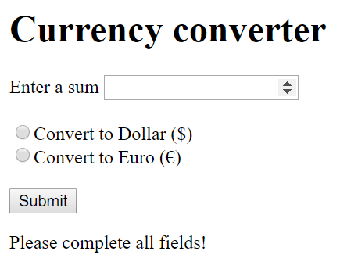
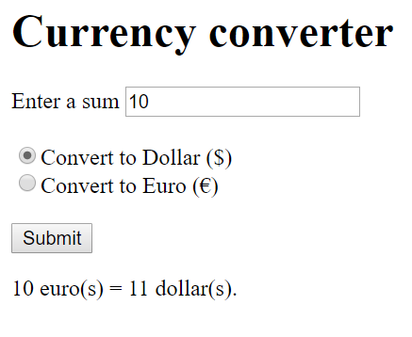
Vue.js : Exercise 19
Notes:
<!DOCTYPE html>
<html>
<meta charset="utf-8"/>
<script src="vue.js"></script>
<body>
<div id="app">
<h1>Currency converter</h1>
Enter a sum <input type="number" v-model="sum" name="sum" min="0"> {{ nb1_error }}<br><br>
<input type="radio" v-model="currency" value ="dollar" name="currency">Convert to Dollar ($) <br>
<input type="radio" v-model="currency" value="euro" name="currency">Convert to Euro (€)</br><br>
<input type="submit" value="Submit" v-on:click="checkForm">
<p> {{ message }} </p>
</div>
<script>
var app = new Vue({
el: '#app',
data: {
sum: null,
currency: null,
message:null
},
methods:{
checkForm: function () {
if (this.sum && this.currency) {
if(this.currency == 'dollar'){
this.message = this.sum + " euro(s) = " + (parseFloat(this.sum) * 1.1) + " dollar(s).";
} else if(this.currency == 'euro'){
this.message = this.sum + " dollar(s) = " + (parseFloat(this.sum) * 0.9) + " euro(s).";
}
} else {
this.message = 'Please complete all fields!';
}
}
}
})
</script>
</body>
</html>

Slide 72
Vue.js : Corrected 19 (1)
<!DOCTYPE html>
<html>
<meta charset="utf-8" />
<script src="https://unpkg.com/vue@next"></script>
<body>
<div id="app">
<h1>Currency converter</h1>
Enter a sum <input type="number" v-model="sum" name="sum" min="0">
<input type="radio" v-model="currency" value ="dollar" name="currency">
Convert to Dollar ($) <br>
<input type="radio" v-model="currency" value="euro" name="currency">
Convert to Euro (€)</br><br>
<input type="submit" value="Submit" v-on:click="checkForm">
<p> {{ message }} </p>
</div>

Slide 73
Vue.js : Corrected 19 (2)
<script>
const app = Vue.createApp({
data() {
return {
sum: null,
currency: null,
message:null
}
},
methods: {
checkForm: function () {
if (this.sum && this.currency) {
if(this.currency == 'dollar'){
this.message = this.sum +" euro(s) = "+ (parseFloat(this.sum) * 1.1) +" dollar(s)."
} else if(this.currency == 'euro'){
this.message = this.sum +" dollar(s) = "+ (parseFloat(this.sum) * 0.9) +" euro(s)."
}
} else {
this.message = 'Please complete all fields!';
}
}
}
}).mount('#app')
</script>
</body>
</html>​

Slide 74
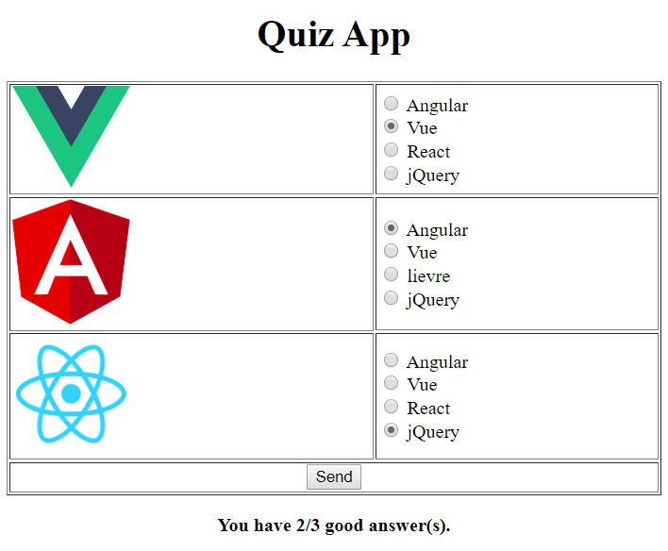
Vue.js : Exercise 20
Notes:
<!DOCTYPE html>
<html>
<meta charset="utf-8"/>
<script src="vue.js"></script>
<body>
<div id="app">
<h1 align=center>Quiz App</h1>
<table border=1 width=100%>
<tr>
<td><img src="v.png" width=100px></td>
<td>
<label><input type="radio" name="q1" v-model="q1" value="angular"> Angular</label><br/>
<label><input type="radio" name="q1" v-model="q1" value="vue"> Vue</label><br/>
<label><input type="radio" name="q1" v-model="q1" value="react"> React</label><br/>
<label><input type="radio" name="q1" v-model="q1" value="jquery"> jQuery</label>
</td>
</tr>
<tr>
<td><img src="a.png" width=100px></td>
<td>
<label><input type="radio" name="q2" v-model="q2" value="angular"> Angular</label><br/>
<label><input type="radio" name="q2" v-model="q2" value="vue"> Vue</label><br/>
<label><input type="radio" name="q2" v-model="q2" value="react"> lievre</label><br/>
<label><input type="radio" name="q2" v-model="q2" value="jquery"> jQuery</label>
</td>
</tr>
<tr>
<td><img src="r.png" width=100px></td>
<td>
<label><input type="radio" name="q3" v-model="q3" value="angular"> Angular</label><br/>
<label><input type="radio" name="q3" v-model="q3" value="vue"> Vue</label><br/>
<label><input type="radio" name="q3" v-model="q3" value="react"> React</label><br/>
<label><input type="radio" name="q3" v-model="q3" value="jquery"> jQuery</label>
</td>
</tr>
<tr>
<td colspan="2" align=center>
<button v-on:click="checkForm">Send</button>
</td>
</tr>
</table>
<p align=center><strong>{{ message }}</strong></p>
</div>
<script>
var app = new Vue({
el: '#app',
data: {
count: 0,
q1:null,
q2:null,
q3:null,
message:null
},
methods:{
checkForm: function () {
if (this.q1 && this.q2 && this.q3) {
if(this.q1 == 'vue') { this.count++; }
if(this.q2 == 'angular'){ this.count++; }
if(this.q3 == 'react') { this.count++; }
this.message = 'You have ' + this.count + '/3 good answer(s).';
} else {
this.message = 'Please complete all fields!';
}
}
}
})
</script>
</body>
</html>

Slide 75
Vue.js : Corrected 20 (1)
<!DOCTYPE html>
<html>
<meta charset="utf-8" />
<script src="https://unpkg.com/vue@next"></script>
<body>
<div id="app">
<h1 align=center>Quiz App</h1>
<table border=1 width=100%>
<tr>
<td><img src="v.png" width=100px></td>
<td>
<label><input type="radio" name="q1" v-model="q1" value="angular"> Angular</label><br />
<label><input type="radio" name="q1" v-model="q1" value="vue"> Vue</label><br />
<label><input type="radio" name="q1" v-model="q1" value="react"> React</label><br />
<label><input type="radio" name="q1" v-model="q1" value="jquery"> jQuery</label>
</td>
</tr>
<tr>
<td><img src="a.png" width=100px></td>
<td>
<label><input type="radio" name="q2" v-model="q2" value="angular"> Angular</label><br />
<label><input type="radio" name="q2" v-model="q2" value="vue"> Vue</label><br />
<label><input type="radio" name="q2" v-model="q2" value="react"> lievre</label><br />
<label><input type="radio" name="q2" v-model="q2" value="jquery"> jQuery</label>
</td>
</tr>

Slide 76
Vue.js : Corrected 20 (2)
<tr>
<td><img src="r.png" width=100px></td>
<td>
<label><input type="radio" name="q3" v-model="q3" value="angular"> Angular</label><br />
<label><input type="radio" name="q3" v-model="q3" value="vue"> Vue</label><br />
<label><input type="radio" name="q3" v-model="q3" value="react"> React</label><br />
<label><input type="radio" name="q3" v-model="q3" value="jquery"> jQuery</label>
</td>
</tr>
<tr>
<td colspan="2" align=center>
<button v-on:click="checkForm">Send</button>
</td>
</tr>
</table>
<p align=center><strong>{{ message }}</strong></p>
</div>

Slide 77
Vue.js : Corrected 20 (3)
<script>
const app = Vue.createApp({
data() {
return {
count: 0,
q1: null,
q2: null,
q3: null,
message: null
}
},
methods: {
checkForm: function () {
if (this.q1 && this.q2 && this.q3) {
if (this.q1 == 'vue') { this.count++; }
if (this.q2 == 'angular') { this.count++; }
if (this.q3 == 'react') { this.count++; }
this.message = 'You have ' + this.count + '/3 good answer(s).';
} else {
this.message = 'Please complete all fields!';
}
}
}
}).mount('#app')
</script>
</body>
</html>

Slide 78
WS REST

Slide 79
Vue.js : API REST : Ressource (users.json)
{
"success": true,
"results": {
"nb": 4,
"users": [
{
"id": "3",
"firstname": "nicolas",
"lastname": "elbaz",
},
{
"id": "2",
"firstname": "christel",
"lastname": "lavaut",
},
{
"id": "1",
"firstname": "bahri",
"lastname": "mohammed",
}
]
}
}

Slide 80
Vue.js : API REST : Client Vue (index.html)
<!DOCTYPE html>
<html>
<script src="https://unpkg.com/vue@next"></script>
<script src="https://unpkg.com/axios/dist/axios.min.js"></script>
<body>
<div id="app">
{{ info }}
</div>
<script>
const app = Vue.createApp({
data() {
return {
info: null
}
},
mounted() {
axios
.get('http://localhost/api/user.json')
.then(response => (this.info = response.data))
}
}).mount('#app')
</script>
</body>
</html>

Slide 81
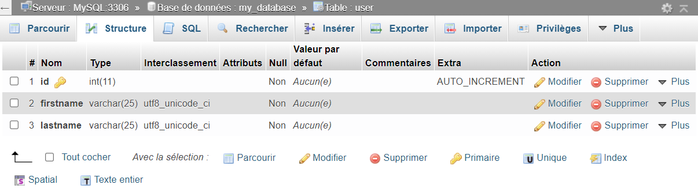
Vue.js : API REST : User Table

Slide 82
Vue.js : API REST : Server [ api/user.php ]
<?php
header('Content-Type: application/json');
$hote = 'localhost';
$database = 'my_database';
$root = 'root';
$password = '';
$pdo = new PDO('mysql:host=' . $hote . ';dbname=' . $database, $root, $password);
$return = [];
if($_SERVER['REQUEST_METHOD'] === 'GET'){
if( !empty($_GET['id']) ){
$query = $pdo->prepare('SELECT * FROM user WHERE id LIKE :id');
$query->bindParam(':id', $_GET['id']);
$query->execute();
} else {
$query = $pdo->prepare('SELECT * FROM `user`');
$query->execute();
}
$result = $query->fetchAll(PDO::FETCH_ASSOC);
$return['success'] = true;
$return['body'] = $result;
}
Notes:
<!DOCTYPE html>
<html>
<body>
Success : <p id="success"></p>
Message : <p id="message"></p>
Nombres de users : <p id="nb"></p>
Le premier user : <p id="user"></p>
Tous les users : <p id="users"></p>
<script>
var xmlhttp = new XMLHttpRequest();
xmlhttp.onreadystatechange = function() {
if (this.readyState == 4 && this.status == 200) {
var retour = JSON.parse(this.responseText);
document.getElementById("success").innerHTML = retour.success;
document.getElementById("message").innerHTML = retour.message;
document.getElementById("nb").innerHTML = retour.nb;
document.getElementById("users").innerHTML = JSON.stringify(retour.users);
document.getElementById("user").innerHTML = retour.users[0].firstname;
}
};
xmlhttp.open("GET", "users.php", true);
xmlhttp.send();
</script>
</body>
</html>

Slide 83
Vue.js : API REST : Server [ api/user.php ]
else if($_SERVER['REQUEST_METHOD'] === 'POST'){
if( !empty($_POST['firstname']) && !empty($_POST['lastname']) ){
$query = $pdo->prepare('INSERT INTO user (firstname, lastname) VALUES (:firstname, :lastname);');
$query->bindParam(':firstname', $_POST['firstname']);
$query->bindParam(':lastname', $_POST['lastname']);
$query->execute();
$return['success'] = true;
$return['body'] = 'SUCCESS : The user (' . $pdo->lastInsertId() . ') has been successfully added !';
} else {
$return['success'] = false;
$return['body'] = 'ERROR : Request Problem !';
}
}
Notes:
<!DOCTYPE html>
<html>
<body>
Success : <p id="success"></p>
Message : <p id="message"></p>
Nombres de users : <p id="nb"></p>
Le premier user : <p id="user"></p>
Tous les users : <p id="users"></p>
<script>
var xmlhttp = new XMLHttpRequest();
xmlhttp.onreadystatechange = function() {
if (this.readyState == 4 && this.status == 200) {
var retour = JSON.parse(this.responseText);
document.getElementById("success").innerHTML = retour.success;
document.getElementById("message").innerHTML = retour.message;
document.getElementById("nb").innerHTML = retour.nb;
document.getElementById("users").innerHTML = JSON.stringify(retour.users);
document.getElementById("user").innerHTML = retour.users[0].firstname;
}
};
xmlhttp.open("GET", "users.php", true);
xmlhttp.send();
</script>
</body>
</html>

Slide 84
Vue.js : API REST : Server [ api/user.php ]
else if($_SERVER['REQUEST_METHOD'] === 'PUT'){
if( !empty($_GET['id']) && !empty($_GET['firstname']) && !empty($_GET['lastname']) ){
$query = $pdo->prepare('UPDATE `user` SET `firstname` = :firstname, `lastname` = :lastname WHERE `user`.`id` = :id;');
$query->bindParam(':id', $_GET['id']);
$query->bindParam(':firstname', $_GET['firstname']);
$query->bindParam(':lastname', $_GET['lastname']);
$query->execute();
$return['success'] = true;
$return['body'] = 'SUCCESS : The user (' . $_GET['id'] . ') has been successfully modified !';
} else {
$return['success'] = false;
$return['body'] = 'ERROR : Request Problem !';
}
}
Notes:
<!DOCTYPE html>
<html>
<body>
Success : <p id="success"></p>
Message : <p id="message"></p>
Nombres de users : <p id="nb"></p>
Le premier user : <p id="user"></p>
Tous les users : <p id="users"></p>
<script>
var xmlhttp = new XMLHttpRequest();
xmlhttp.onreadystatechange = function() {
if (this.readyState == 4 && this.status == 200) {
var retour = JSON.parse(this.responseText);
document.getElementById("success").innerHTML = retour.success;
document.getElementById("message").innerHTML = retour.message;
document.getElementById("nb").innerHTML = retour.nb;
document.getElementById("users").innerHTML = JSON.stringify(retour.users);
document.getElementById("user").innerHTML = retour.users[0].firstname;
}
};
xmlhttp.open("GET", "users.php", true);
xmlhttp.send();
</script>
</body>
</html>

Slide 85
Vue.js : API REST : Server [ api/user.php ]
else if($_SERVER['REQUEST_METHOD'] === 'DELETE'){
if( !empty($_GET['id'])){
$query = $pdo->prepare('DELETE FROM `user` WHERE `user`.`id` = :id;');
$query->bindParam(':id', $_GET['id']);
$query->execute();
$return['success'] = true;
$return['body'] = 'SUCCESS : The user (' . $_GET['id'] . ') has been successfully deleted !';
} else {
$return['success'] = false;
$return['body'] = 'ERROR : Request Problem !';
}
}
echo json_encode($return);
Notes:
<!DOCTYPE html>
<html>
<body>
Success : <p id="success"></p>
Message : <p id="message"></p>
Nombres de users : <p id="nb"></p>
Le premier user : <p id="user"></p>
Tous les users : <p id="users"></p>
<script>
var xmlhttp = new XMLHttpRequest();
xmlhttp.onreadystatechange = function() {
if (this.readyState == 4 && this.status == 200) {
var retour = JSON.parse(this.responseText);
document.getElementById("success").innerHTML = retour.success;
document.getElementById("message").innerHTML = retour.message;
document.getElementById("nb").innerHTML = retour.nb;
document.getElementById("users").innerHTML = JSON.stringify(retour.users);
document.getElementById("user").innerHTML = retour.users[0].firstname;
}
};
xmlhttp.open("GET", "users.php", true);
xmlhttp.send();
</script>
</body>
</html>

Slide 86
Vue.js : API REST : Vue Client
<!DOCTYPE html>
<html>
<script src="https://unpkg.com/vue@next"></script>
<script src="https://unpkg.com/axios/dist/axios.min.js"></script>
<body>
<div id="app">
{{ findAll() }}
<p>{{ info }}</p>
</div>
<script>
const app = Vue.createApp({
data() {
return {
info: null
}
},
methods: {
/* GET METHOD */
findAll: function () {
axios.get('http://localhost/api/user.php')
.then(response => (this.info = response.data))
},
findById: function (id) {
axios.get('http://localhost/api/user.php?id=' + id)
.then(response => (this.info = response.data))
},
Notes:
<!DOCTYPE html>
<html>
<body>
Success : <p id="success"></p>
Message : <p id="message"></p>
Nombres de users : <p id="nb"></p>
Le premier user : <p id="user"></p>
Tous les users : <p id="users"></p>
<script>
var xmlhttp = new XMLHttpRequest();
xmlhttp.onreadystatechange = function() {
if (this.readyState == 4 && this.status == 200) {
var retour = JSON.parse(this.responseText);
document.getElementById("success").innerHTML = retour.success;
document.getElementById("message").innerHTML = retour.message;
document.getElementById("nb").innerHTML = retour.nb;
document.getElementById("users").innerHTML = JSON.stringify(retour.users);
document.getElementById("user").innerHTML = retour.users[0].firstname;
}
};
xmlhttp.open("GET", "users.php", true);
xmlhttp.send();
</script>
</body>
</html>

Slide 87
Vue.js : API REST : Vue Client
/* POST METHOD */
add: function (firstname, lastname) {
let fd = new FormData()
fd.append('firstname', firstname)
fd.append('lastname', lastname)
axios.post("http://localhost/api/user.php", fd)
.then(response => (this.info = response.data))
},
/* PUT METHOD */
update: function (id, firstname, lastname) {
axios.put("http://localhost/api/user.php?id=" + id + "&firstname=" + firstname + "&lastname=" + lastname)
.then(response => (this.info = response.data))
},
/* DELETE METHOD */
remove: function (id) {
axios.delete("http://localhost/api/user.php?id=" + id)
.then(response => this.info = response.data);
}
}
}).mount('#app')
</script>
</body>
</html>
Notes:
<!DOCTYPE html>
<html>
<body>
Success : <p id="success"></p>
Message : <p id="message"></p>
Nombres de users : <p id="nb"></p>
Le premier user : <p id="user"></p>
Tous les users : <p id="users"></p>
<script>
var xmlhttp = new XMLHttpRequest();
xmlhttp.onreadystatechange = function() {
if (this.readyState == 4 && this.status == 200) {
var retour = JSON.parse(this.responseText);
document.getElementById("success").innerHTML = retour.success;
document.getElementById("message").innerHTML = retour.message;
document.getElementById("nb").innerHTML = retour.nb;
document.getElementById("users").innerHTML = JSON.stringify(retour.users);
document.getElementById("user").innerHTML = retour.users[0].firstname;
}
};
xmlhttp.open("GET", "users.php", true);
xmlhttp.send();
</script>
</body>
</html>

